Slide 1


Name: Thomas Flynn
ID: 16117743
Course: Information & Network Security MEng
Supervisor: Dr. Sean McGrath
Project Title: Docker Containers Deployed Using Bluemix
Containerization platform
Linux OS
Open source
Packages application code
Platform as a service
Integrates Docker
Bare metal depoyment
Container lifecycle management

Slide 2
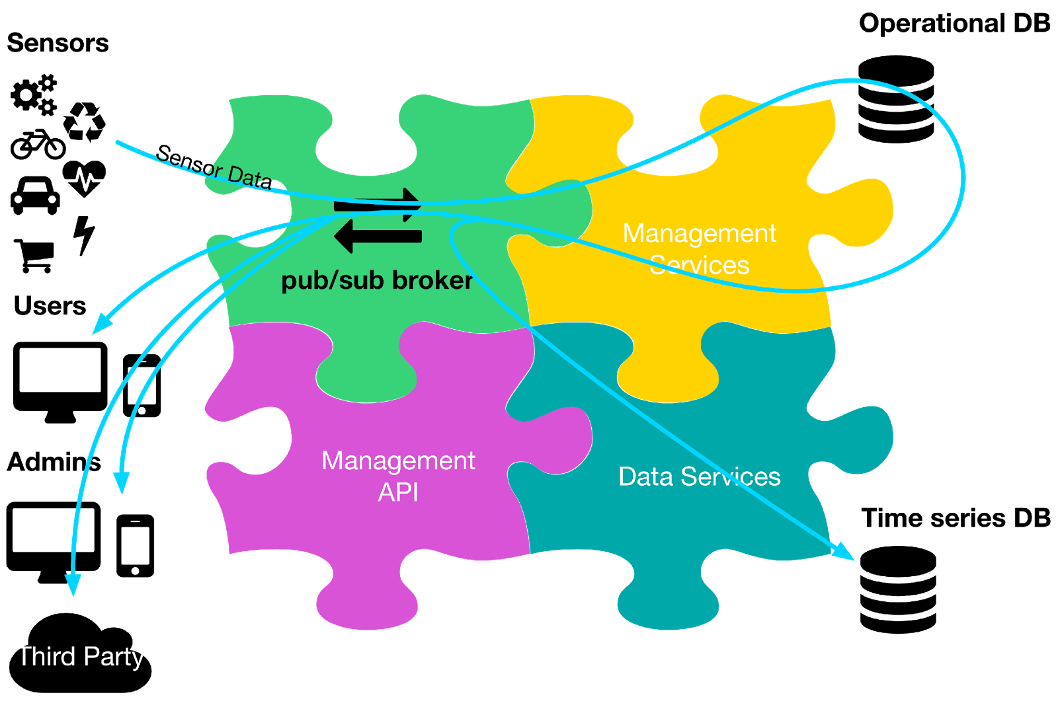
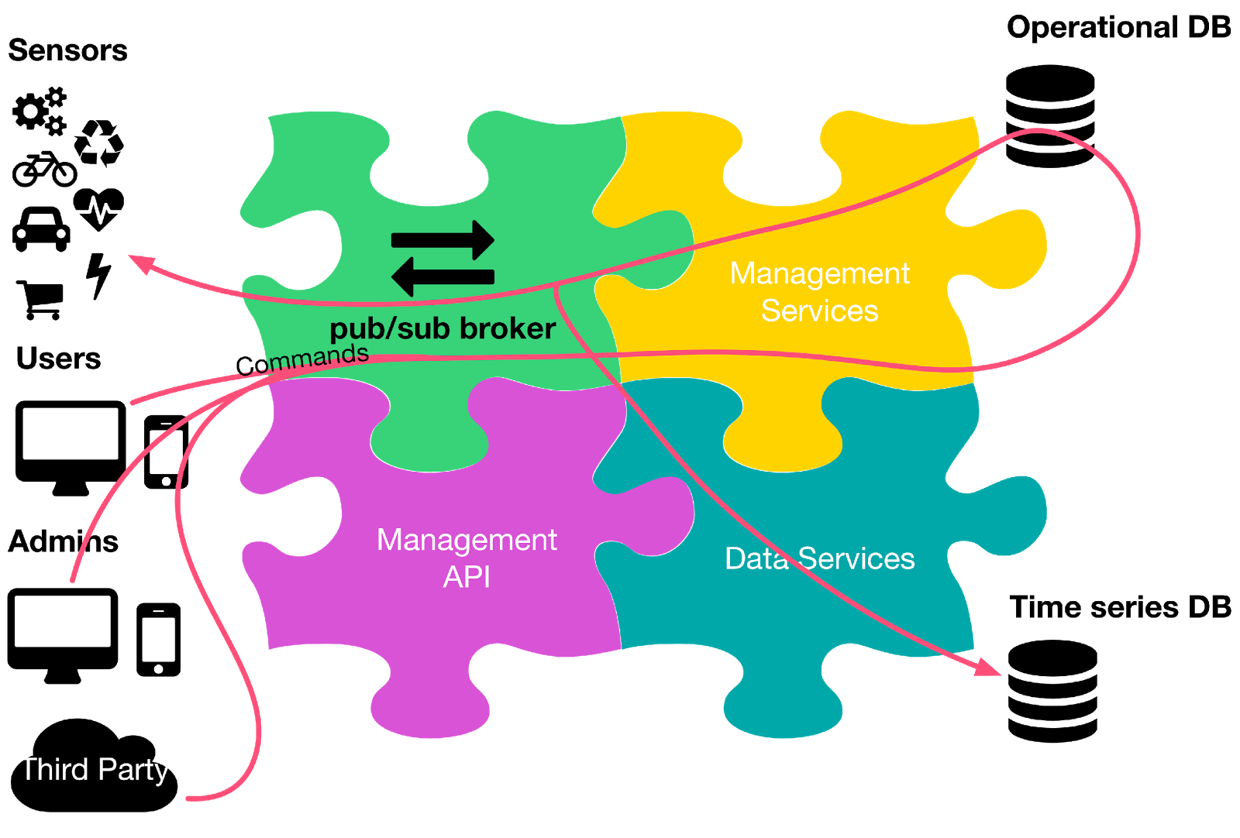
IoT Architecture
Sensor Data Flow
Command Flow
Sensor API
Called by the sensors to deliver data readings and receive commands
Called by the sensors to retrieve real-time data, historical data, and to manage the devices
Responsible for authentication and authorization, among other things
Responsible for storing and analyzing the data in real time or offline
Public API
Operational Services
Data Services

Slide 3



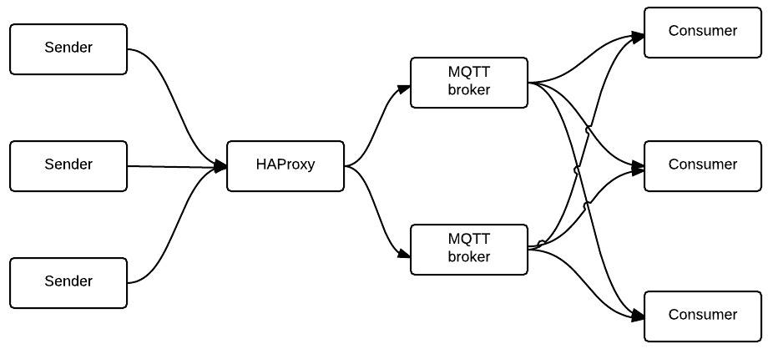

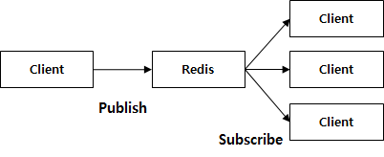
Technologies
Open source MQTT broker written in Javascript
MQTT 3.1 and 3.1.1 compliant
QoS 0 and QoS 1
Various storage options for QoS 1 offline packets, and subscriptions
Usable inside any other Node.js app
Open source software load balancer
Written in C
Session consists of two TCP connections
One from the client to the load balancer
One from the load balancer to the server
Loadbalancing policy specified in config file
Open source, BSD licensed
In-memory data store
Can be used as a high-performance database, a cache, and a message broker
Various clients written in several languages
Log aggregation
Various data structures

Slide 4
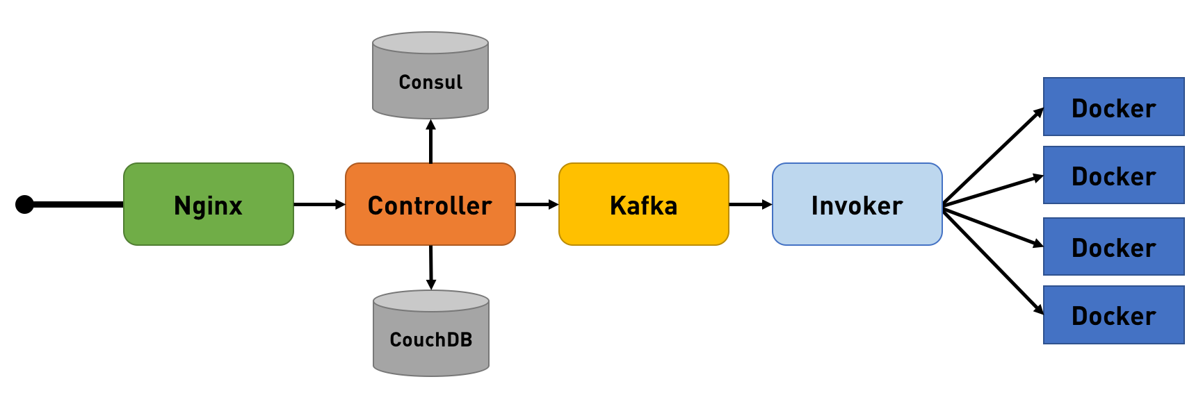

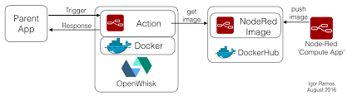




Database
Serverless architecture
Abstracts away infrastructure
Makes it simple to deploy microservices
Eliminates the need to manage your own message broker or deploy your own worker servers
Triggers: A class of events emitted by event sources
Actions: Encapsulates the actual code to be executed
Rules: An association between a trigger and an action
Packages: Describe external services in a uniform manner
Trigger, Action, Rules
Managed NoSQL JSON database service
Cloudant Geo
Index – efficiently via algorithms optimized for spatial data
Query – using complex polygons and geometric relations
Visualize – with interactive maps, powered by Mapbox, directly in the Cloudant dashboard
Open source, written in Go
Select count (schuman) from student_events
Group by time(5m), schuman
Where time > now() - 30m

Slide 5
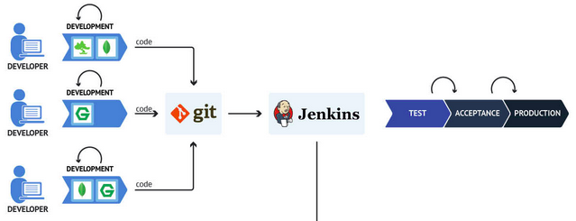



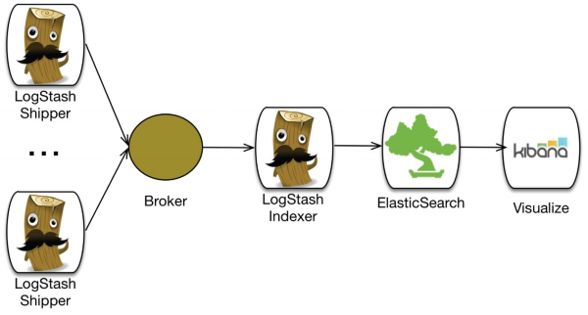



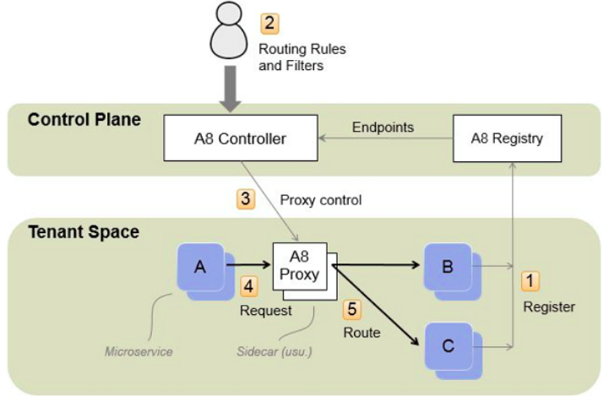
DevOps Tools
Container Lifecycle Management
Scaling
Integration Testing
Container monitoring
CI/CD pipeline
Git sync
Distributed, RESTful search and analytics engine
Open source, server-side data processing pipeline that ingests data
Kibana helps visualize Elasticsearch data and navigate the Elastic Stack
Microservice management framework that provides systematic resiliency testing and red/black deployment
Registry – A high-performance service registry that provides a centralized view of all the microservices in an application, regardless of where they are actually running
Controller – A tool that monitors the Registry and provides a REST API for registering routing and other microservice control-rules, which it uses to generate and send control information to proxy servers running within the application

Slide 6







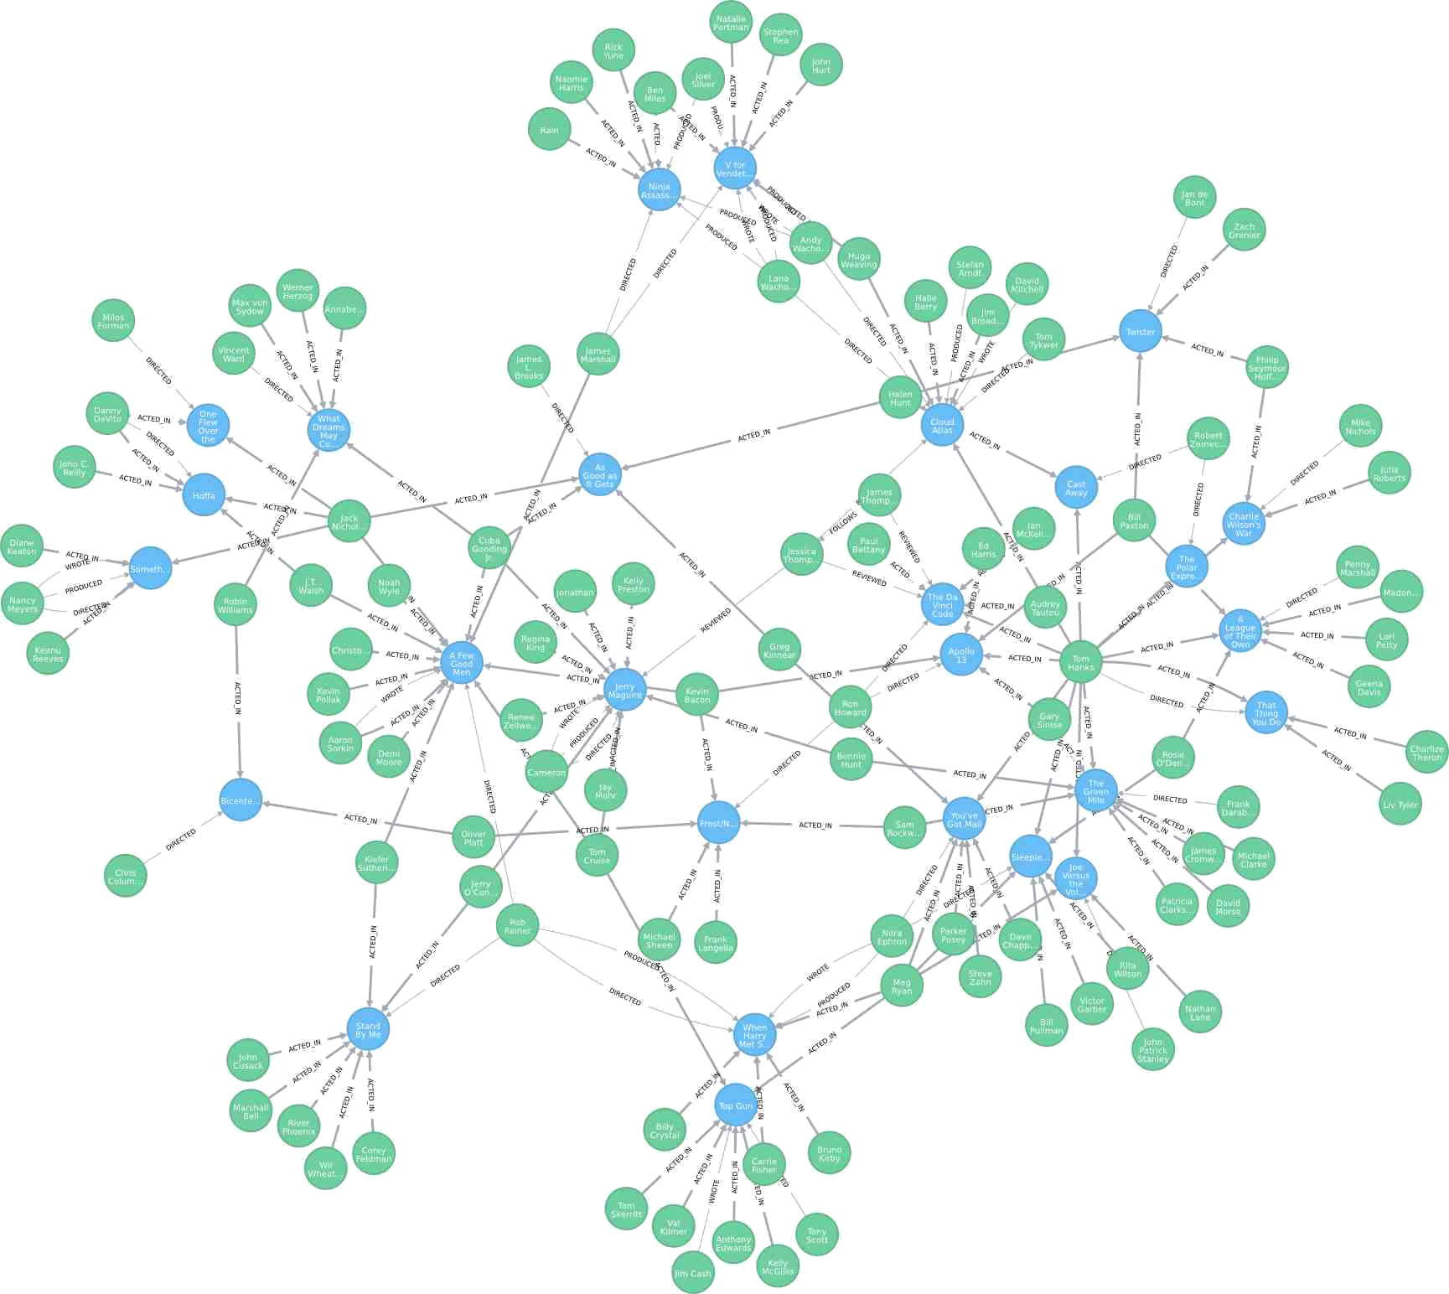


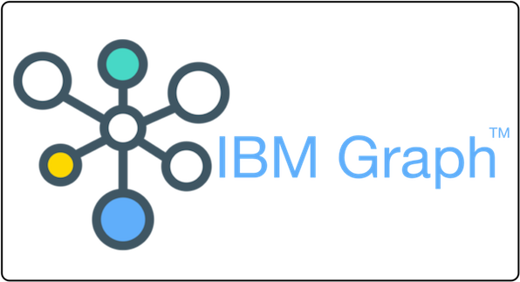
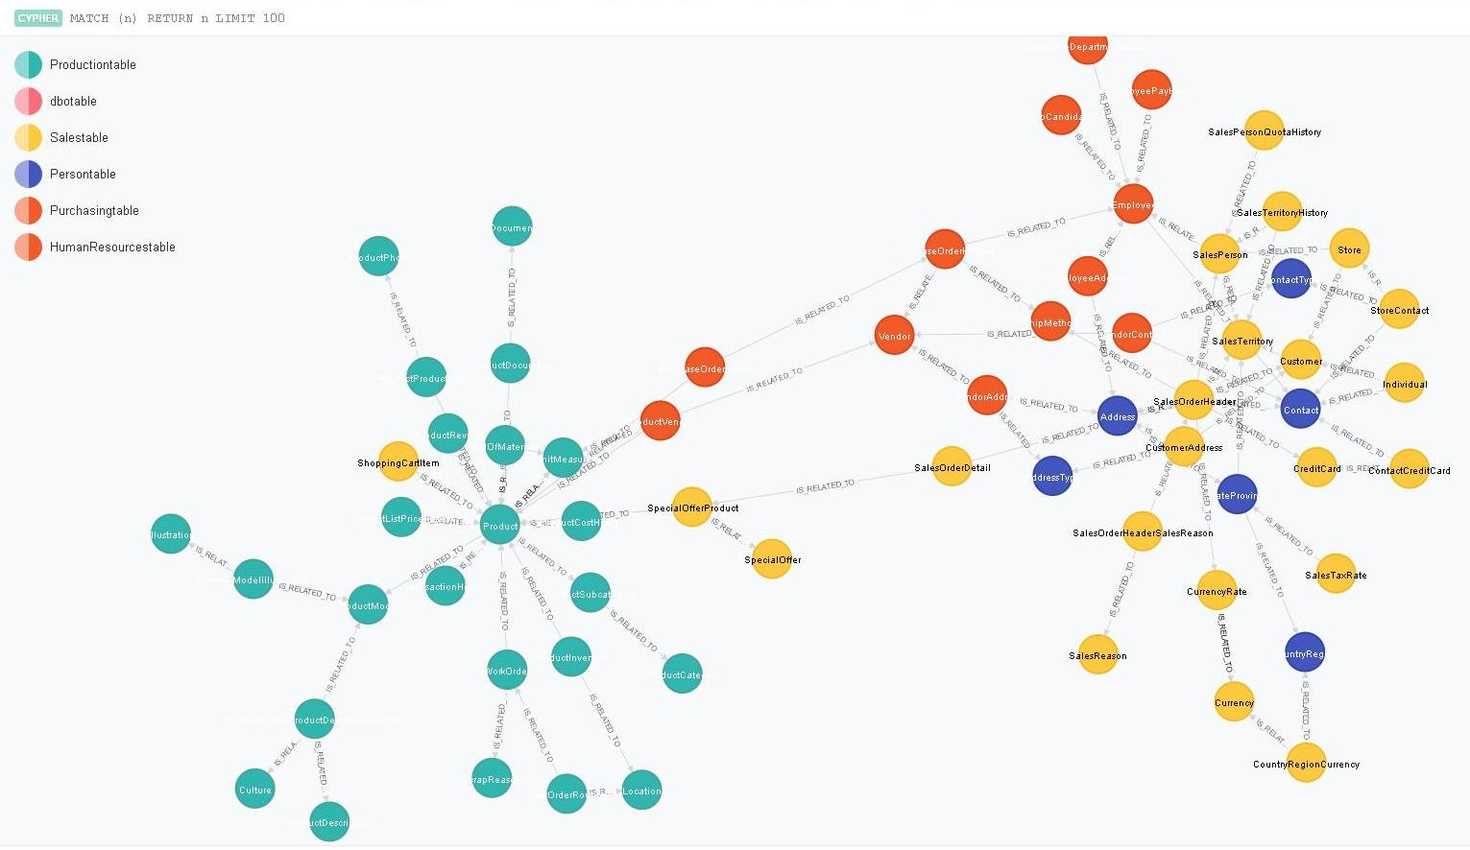

High level design
A2
A1
Description
Activity
B4
Simulate WSN data
A1
Store for a short period
A2
Commit to temporary database
A3
Commit to permanent database
A4
User queries WSN status
B1
Service queries database
B2
B2
Data retrieved
B3
Service transmits data
B4
B1
Data displayed to the user
B5
A3
B3
B5
A4
Temporary
database
Permanent
Database

Slide 7





Overall Architecture
OpenWhisk
Encode
MQTT Clients
Load
balancing
MQTT brokers
Persistance
Decode
PUBLISH
JSON Storage DB
REST Clients
URL=TOPIC
POST
Every
5min
Microservice
Management
Update
subscribers
Time-series DB
Analytics

Slide 8

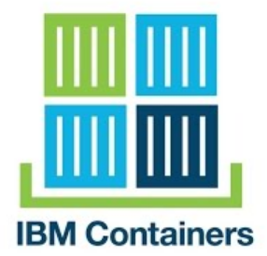

Load Balancing Architecture
Sensor API
MQQT Broker
Data cache
Management Services
P:1883
P:6379
Load Balancing
Mobile Topic
Web Socket
Publish
Publish
IoT Device Topic
Subscribe
Logging and Monitoring

Slide 9
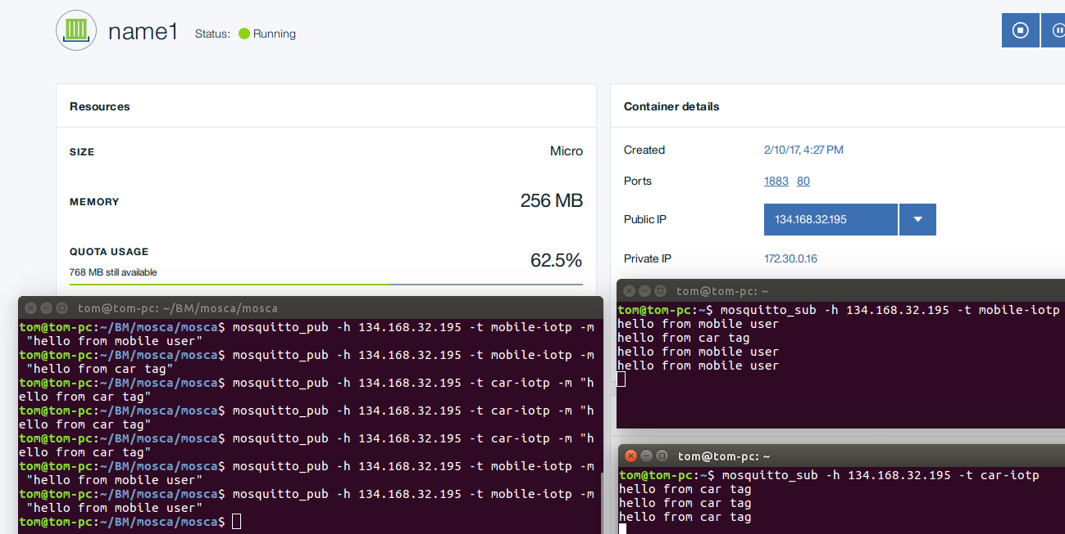

Mosca Broker Test
Mosca Broker running on Bluemix
Mobile
Topic
Car
Topic
Mosquitto Client publishes to “car-iotp” and “mobile-iotp”
Subscribers
Publisher

Slide 10
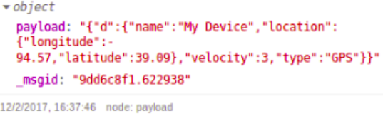
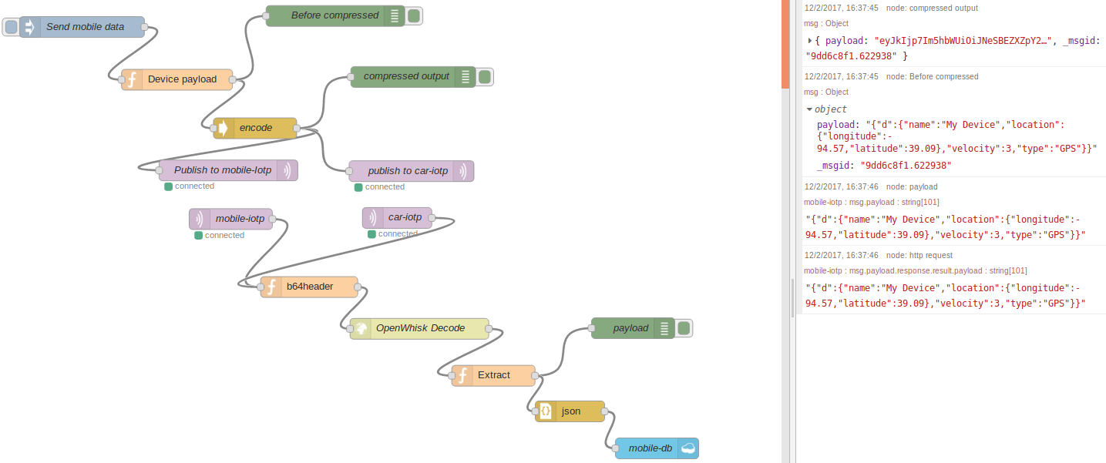
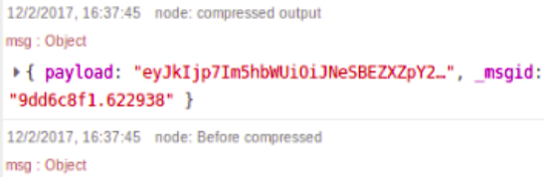

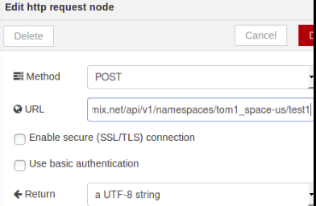
Node-RED Flow
Configure payload frequency
Format MQTT message
Encode to Base64
MQTT Broker
OpenWhisk http request node config
Format header
Msg.payload.response.result.payload
Convert to json
Store in Cloudant

Slide 11
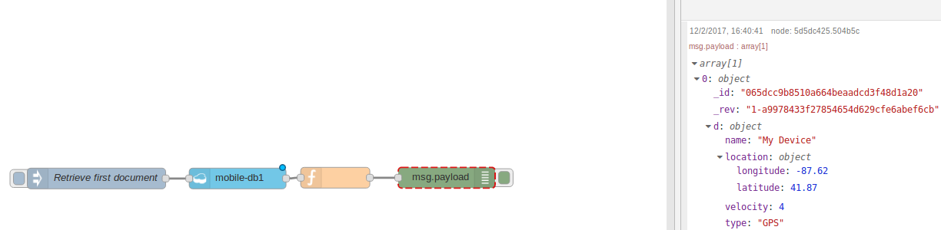
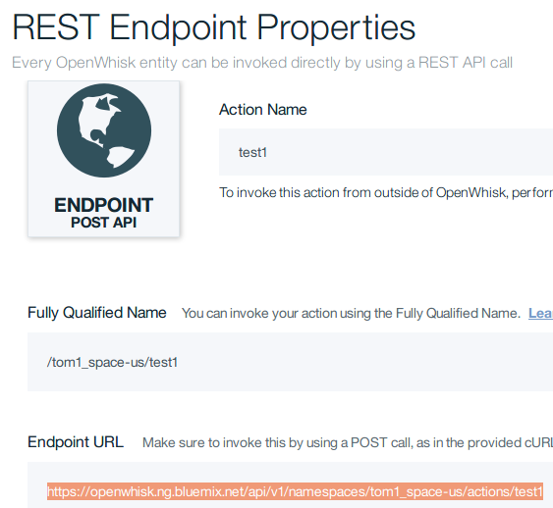
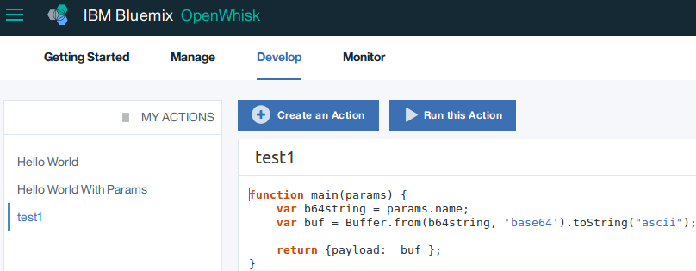
OpenWhisk & Cloudant
Extract msg.payload
OpenWhisk Base64 Decode Action
OpenWhisk Action REST Endpoint

Slide 12
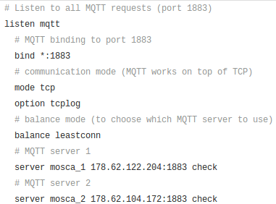
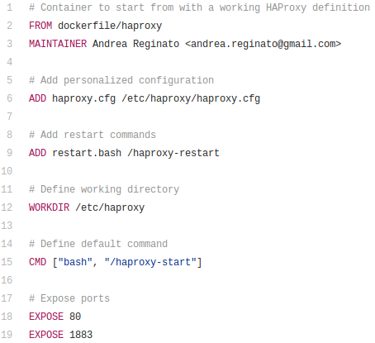
HAProxy
HAProxy Config File
HAProxy listens for traffic on port 1883
Configured to have MQTT work on top of TCP
Chooses the broker with the least amount of connections
Car Broker/Topic
Mobile Broker/Topic
Dockerfile
Builds Container image
Add HAProxy config file to image
Add restart command in order to overide default configurations
Define working directory for container
“haproxy-start” will be the default command run when container is started
Expose ports to other containers on same local network

Slide 13
Work to be completed

Slide 14

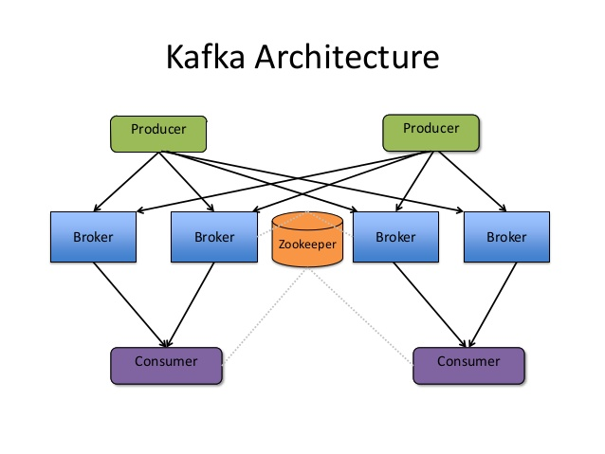
Technologies
Distributed publish-subscribe messaging system
High-throughput
Can support thousands of messages per second
Persistent messaging with disk structures that provide constant time performance even with many TB of stored messages
More than one consumer from a consumer group can retrieve data simultaneously, in the same order that messages are stored
Serverless architecture
Abstracts away infrastructure
Makes it simple to deploy microservices
Eliminates the need to manage your own message broker or deploy your own worker servers
Triggers: A class of events emitted by event sources
Actions: Encapsulates the actual code to be executed
Rules: An association between a trigger and an action
Packages: Describe external services in a uniform manner
OpenWhisk Architecture
OpenWhisk
Trigger, Action, Rules
Managed NoSQL JSON database service
Cloudant Geo
Index – efficiently via algorithms optimized for spatial data
Query – using complex polygons and geometric relations
Visualize – with interactive maps, powered by Mapbox, directly in the Cloudant dashboard

